Slide 1
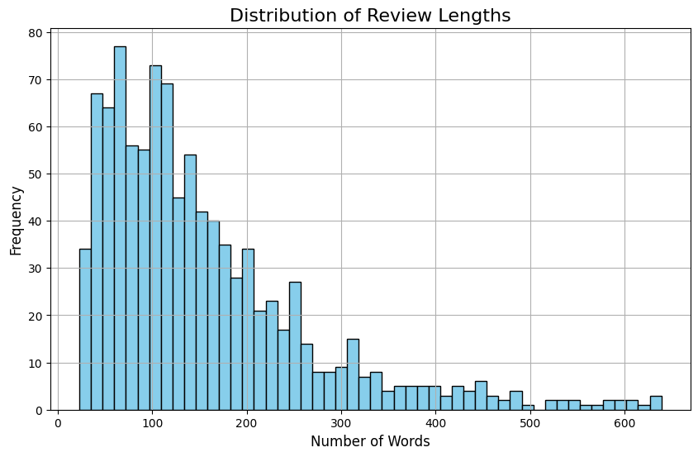
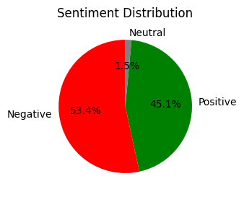
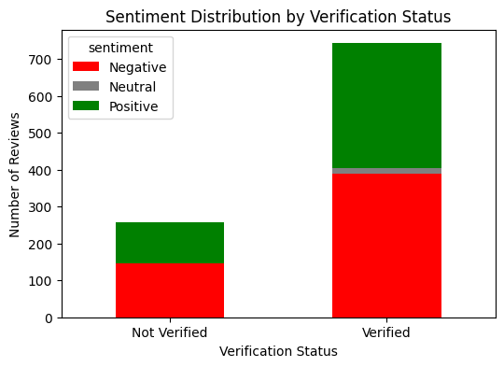
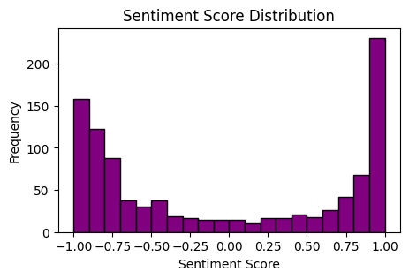
British Airways Review Analysis
Analysis of 1,000 customer reviews to understand sentiment trends and key insights.
Insights 📊
🔹 Review Verification – Out of 1,000 reviews, 743 are verified. The higher number of verified reviews suggests more credible customer feedback.
🔹 Sentiment Distribution – 55% negative, 35% positive, and 10% neutral reviews indicate a strong trend toward dissatisfaction.
🔹 Verified vs. Unverified Reviews – Verified reviews show a balanced sentiment split (50% negative, 40% positive), while unverified reviews lean positive (60% positive, 30% negative), suggesting verified reviews are more representative of customer experience.
🔹 Review Length & Sentiment – Shorter reviews (<150 words) express extreme sentiments, while longer reviews (300+ words) are mostly negative, indicating dissatisfied customers tend to provide more detailed feedback.
🔹 Sentiment Score Distribution – Most reviews fall in the -0.90 to -1.00 range, highlighting widespread dissatisfaction. However, 20% of reviews are highly positive, indicating a significant portion of customers had good experiences.
🔹 Flight, Service, Crew & Seat – Flight issues (delays, cancellations) and service quality are central to negative sentiments, while the crew receives positive feedback, and seat comfort is frequently mentioned as a complaint in negative reviews.
Next Steps & Recommendations 📌
✔ Address Negative Themes – Focus on recurring issues in negative reviews (e.g., customer service, delays) to improve customer experience.
✔ Prioritize Verified Reviews – Verified reviews offer a more balanced and reliable sentiment distribution, making them key for strategic decisions.
✔ Encourage Detailed Feedback – With 75% of reviews under 200 words, prompting customers for more in-depth responses can provide richer insights.
✔ Track Sentiment Trends – Continuously monitor sentiment changes to assess improvements and adjust strategies accordingly.
✔ Focus on Flight & Service Improvements – Address frequent complaints related to flight issues (delays, cancellations) and service quality to improve overall customer satisfaction.
✔ Enhance Seat Comfort – Improve seat comfort based on consistent negative feedback, and track customer sentiment trends for continuous adjustments.
✔ Maintain Positive Crew Feedback – Continue to prioritize crew training and performance to sustain the positive feedback regarding crew members.

